Slide 1

DATABASE MANAGEMENT SYSTEMS
Introduction To SQL
Lab 1
Instructor: Engr Ayesha Khan

Slide 2
Marking scheme
EVALUATION INSTRUMENTS | MARKS
LAB ASSESMENT | 30
ASSIGNMENTS | 10
LAB FILE | 20
PROJECT | 30
LAB VIVA | 10
TOTAL | 100

Slide 3
Software requirements
Sql Server
Follow this link to download and install sql server
Sample Database to be used:
Northwind
Pubs
Adventureworks
Follow this link for installation of northwind db
https://www.youtube.com/watch?v=yasfZuou3zI

Slide 4
INTRODUCTION TO SQL
What is a database?
A database is an organized collection of data.

Slide 5
INTRODUCTION TO SQL
What is a Database Management System?
Database management systems (DBMSs) are specially designed software applications that interact with the user, other applications, and the database itself to capture and analyze data.
Well-known DBMSs include MySQL, MariaDB, PostgreSQL, SQLite, Microsoft SQL Server, Oracle, SAP, dBASE, FoxPro, IBM DB2, LibreOffice Base and FileMaker Pro.

Slide 6
INTRODUCTION TO SQL
What is a Server?
A server is a computer that serves information to other computers.
These other computers are called clients.
Connected through a local area network (LAN) or a wide area network (WAN), such as the Internet.

Slide 7
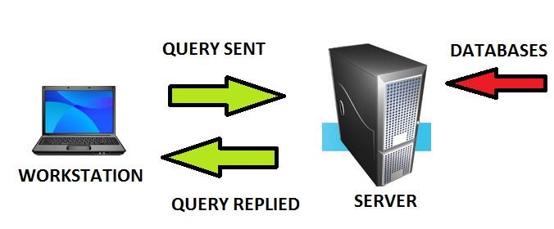
INTRODUCTION TO SQL
What is a Record?
A complete set of information.
Records are composed of fields.

Slide 8
INTRODUCTION TO SQL
What is a field?
A space allocated for a particular item or information.
A collection of fields is called a record.

Slide 9
INTRODUCTION TO SQL
What is SQL?
SQL stands for Structured Query LanguageSQL lets you access and manipulate databases.
What Can SQL do?
SQL can execute queries against a database
SQL can retrieve data from a database
SQL can insert records in a database
SQL can update records in a database
SQL can delete records from a database
SQL can create new databases
SQL can create new tables in a database

Slide 10
INTRODUCTION TO SQL
The SELECT ... FROM Clause
The most basic SELECT statement has only 2 parts:
the columns you want to display and
from the table(s) these columns belong to.

Slide 11
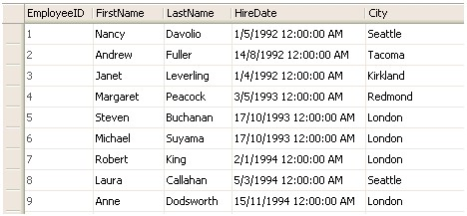
EXAMPLE 1
SELECT EmployeeID, FirstName, LastName, HireDate, City FROM Employees
Select * from Employees

Slide 12
Where Clause
By adding a WHERE clause to the SELECT statement, we add one (or more) conditions that must be met by the selected data. This will limit the number of rows that answer the query and are fetched. In many cases, this is where most of the "action" of a query takes place.

Slide 13
Operators
There are four types of operators:
Comparison Operators
Logical Operators
List Operators
Range Operators

Slide 14
Operator
An operator is a character or a reserved word that is used to specify a condition, or combine two or more conditions. The operators are used with the WHERE clause in the SELECT statement to set the filter criteria for data.

Slide 15
Comparison Operator
Comparison operators are used to compare the column data with specific values in a condition.
Comparison Operator Description
= Equal to
> Greater than
< Less than
>= Greater than or equal to
<= Less than or equal to
<> Not equal to

Slide 16
SQL WHERE and OPERATOR Syntax
SELECT column_name,column_name FROM table_name WHERE column_name operator value

Slide 17
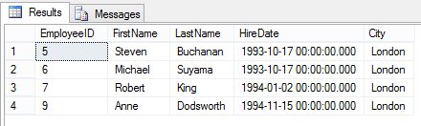
Equal to
SELECT EmployeeID, FirstName, LastName, HireDate, City FROM Employees WHERE City = 'London';

Slide 18
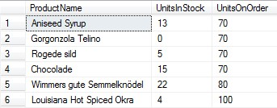
Greater than or equal to
SELECT ProductName,UnitsInStock,UnitsOnOrder FROM Products WHERE UnitsOnOrder >=70

Slide 19
Not equal to
If you wanted to get the opposite, the employees who do not live in London, you would write

Slide 20
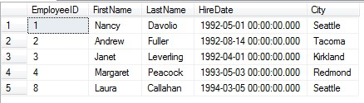
Not equal to
SELECT EmployeeID, FirstName, LastName, HireDate, City FROM Employees WHERE City <> 'London'

Slide 21
Logical Operators
Logical operators are used to test if a specified condition is true or not. They are also used to combine multiple conditions.
Some of the commonly used logical operators are:
OR
Retrieves rows that meet any one of the specified conditions.
AND
Retrieves rows that meet both the conditions.
NOT
Retrieves rows that do not meet the specified condition.
BETWEEN
Retrieves rows where the tested value falls within the specified range.

Slide 22
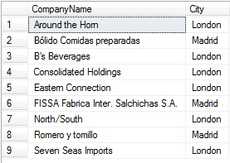
OR OPERATOR
SELECT CompanyName,City FROM Customers WHERE City = 'London' OR City = 'Madrid'

Slide 23
AND OPERATOR
SELECT * FROM Customers WHERE Country='Germany'
AND City='Berlin';

Slide 24
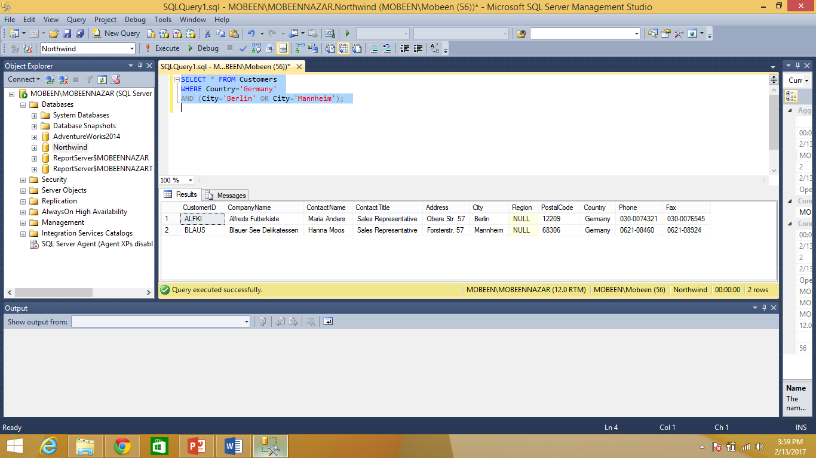
USING AND and OR OPERATOR
SELECT * FROM Customers WHERE Country='Germany' AND (City='Berlin' OR City='Mannheim');

Slide 25
Lab Tasks
Get Order id, Product id, Unit price from Order Details.
Find Title of employee Nancy.
Display data of all employees those working as Sales Representative from London
Display product name whose unit price are greater than 90$
Write a query to get current Product list (Product ID and name).
Fetch data of customers where country is "Germany" AND city must be "Berlin" OR "München" (use parenthesis to form complex expressions)

Slide 26
Lab Tasks
Fetch data of customers from all countries except Germany and USA
Fetch Discontinued products who’s price is greater than 20

